Slide 1
Recycle & Reuse
Sai Krishna Telukuntla, Ashley Harmon.

Slide 2
Problem Statement
There is a need for a better way to reuse items people no longer want, and a way to connect these items to the people who need or could use them.

Slide 3
Usability Goals
Accessibility
Familiarity
Safety
Efficiency
Engaging

Slide 4
Design Goals
Fast, simple means to post items to donate
Fast, simple means to request items you need
Efficient method to match a donator and a donatee
Provide simple, consistent feedback through the donation process
Provide efficient ways to search for items being donated
Increasing availability of resources to people in need
Decided on a mobile app because it best supports the design goals

Slide 5
Main Features of Prototype
Donate an item
File a General Request for Items
Search for Items
Request an Item Directly
Schedule Item Transport
Location Tracking
All without having to communicate with strangers! :D

Slide 6
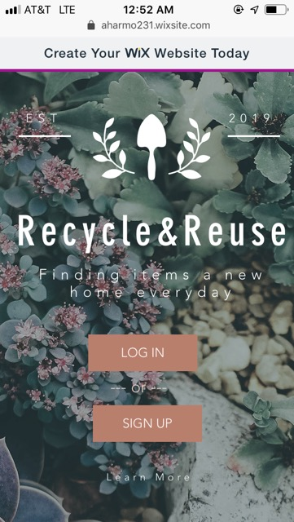
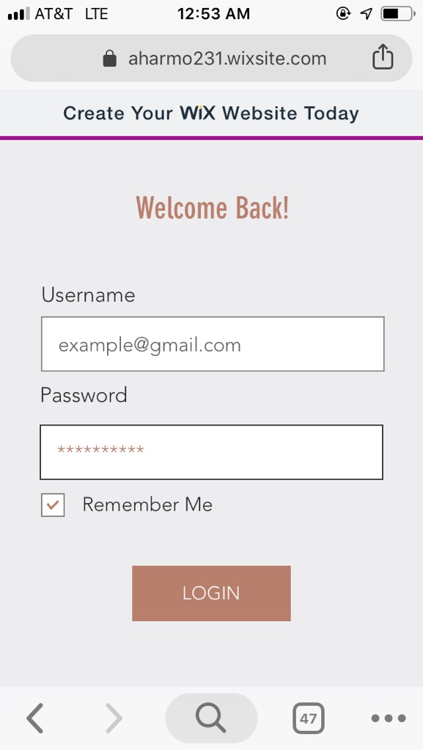
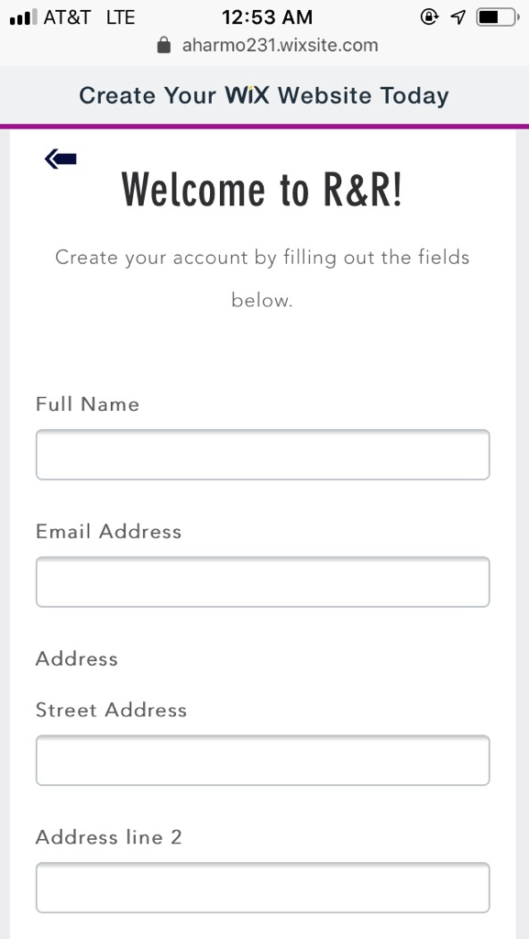
Login or Sign Up
Login
Sign Up
Notes:
Pretty standard login or sign up pages. The Learn More links to our About page. (You can scroll the sign up form).

Slide 7
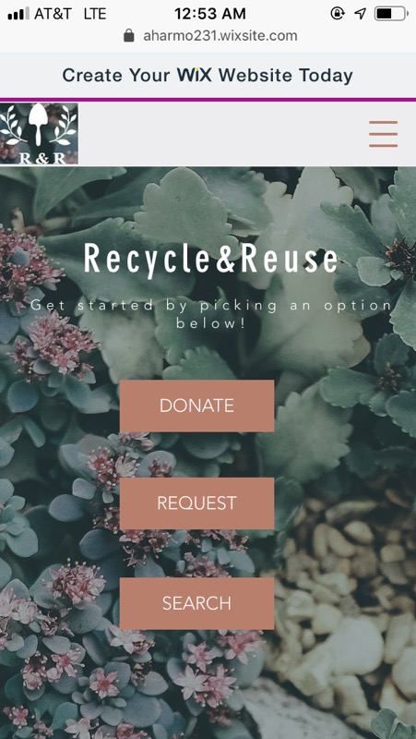
Home Page
Notes:
This is the home page with the 3 main options for using the app.

Slide 8
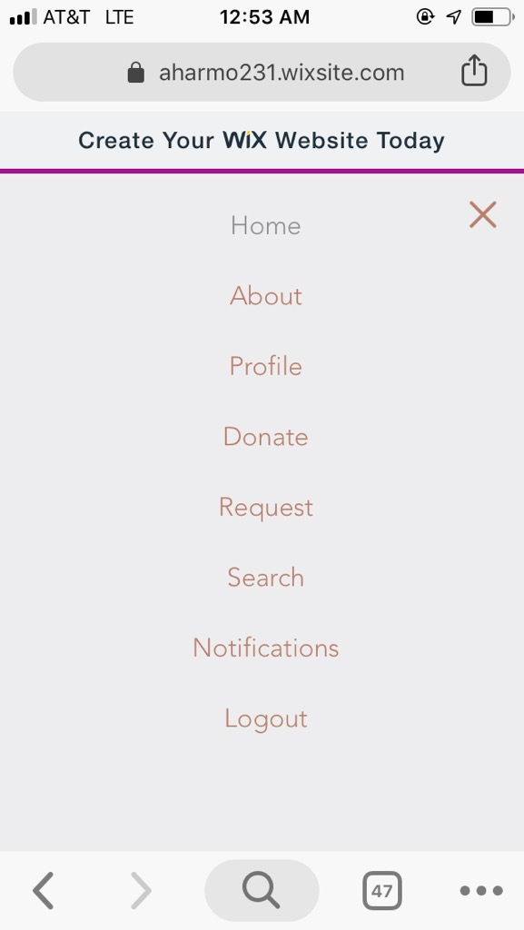
Menu Options
Notes:
These are our menu options for the main areas to access.

Slide 9
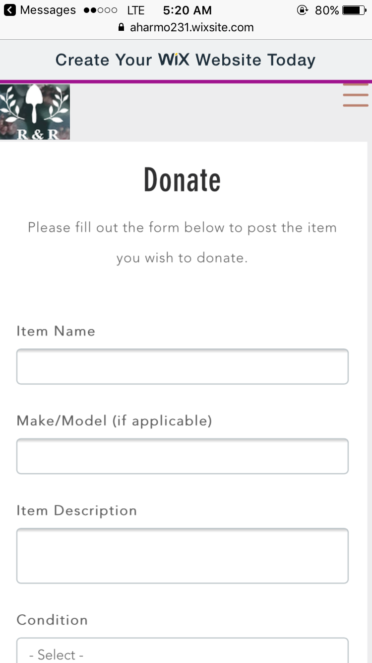
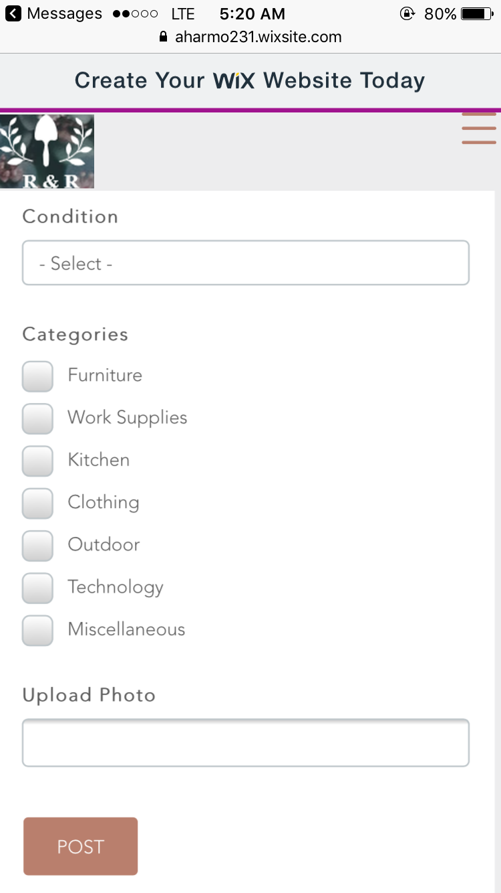
Donating An Item
(scroll)
Notes:
This is the form to upload an item to donate.

Slide 10
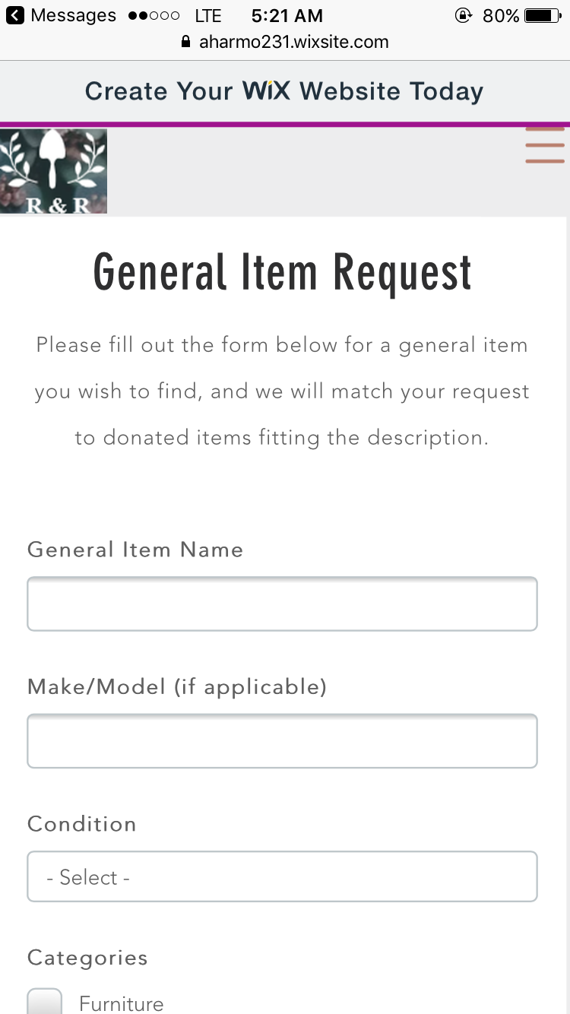
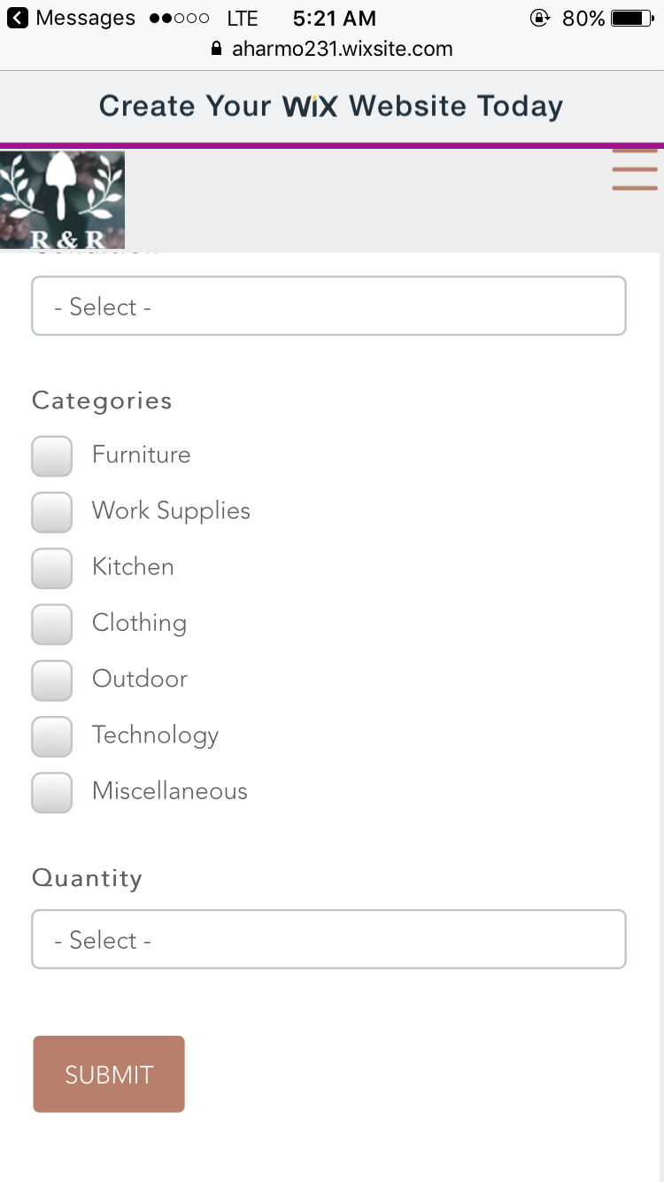
Requesting An Item
(scroll)
Notes:
This is the form to request general items, skip the searching. You are then alerted if something matching that description is found.

Slide 11
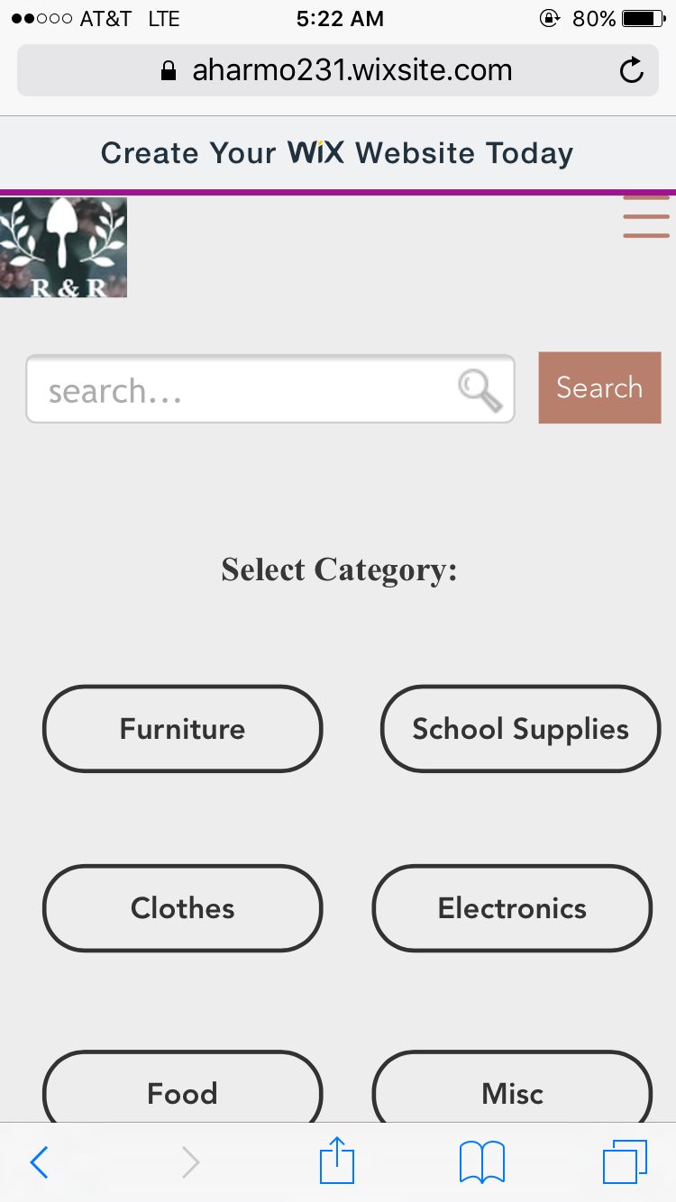
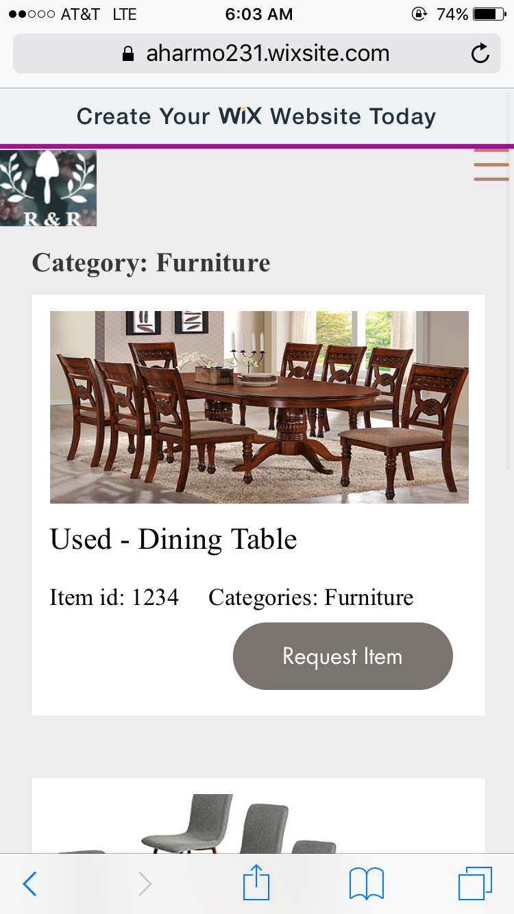
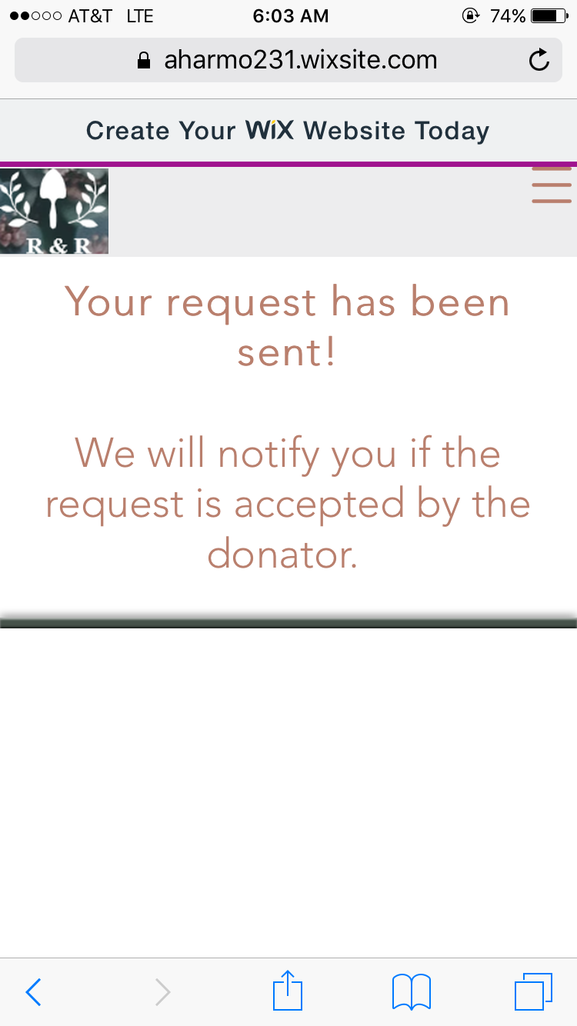
Searching & Requesting
Notes:
You can search for items with the search bar or by category. If you request an item, you get that message.

Slide 12
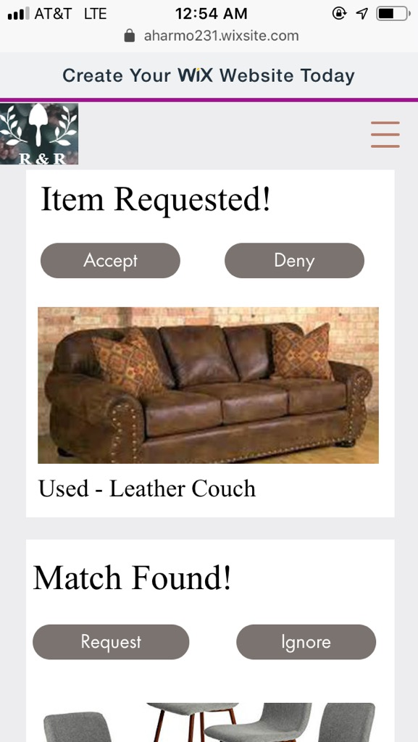
Notifications
Notes:
This is what general notifications look like. If your donated item receives a request (top) or an item matching what you requested through the general request form is found (bottom)

Slide 13
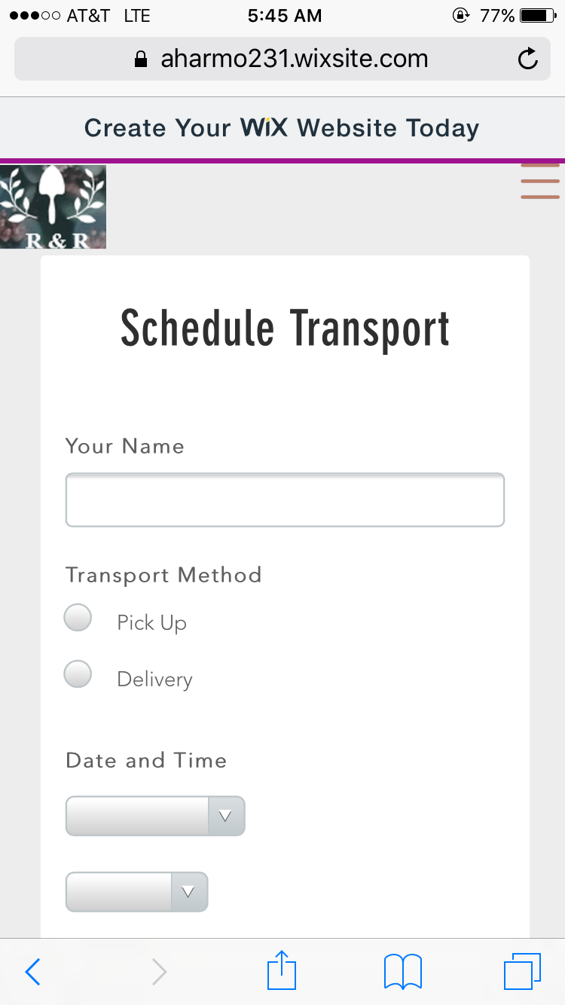
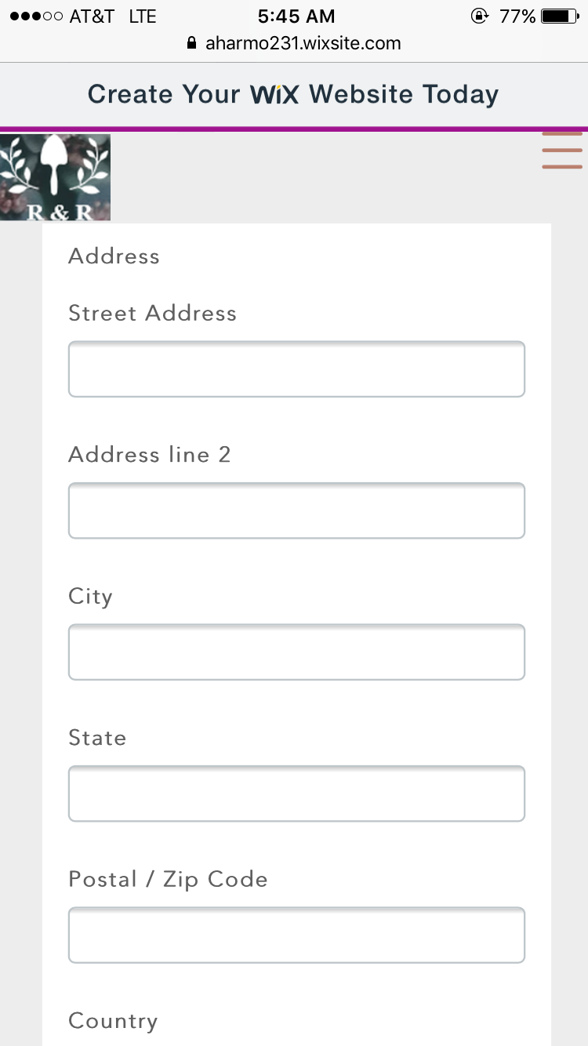
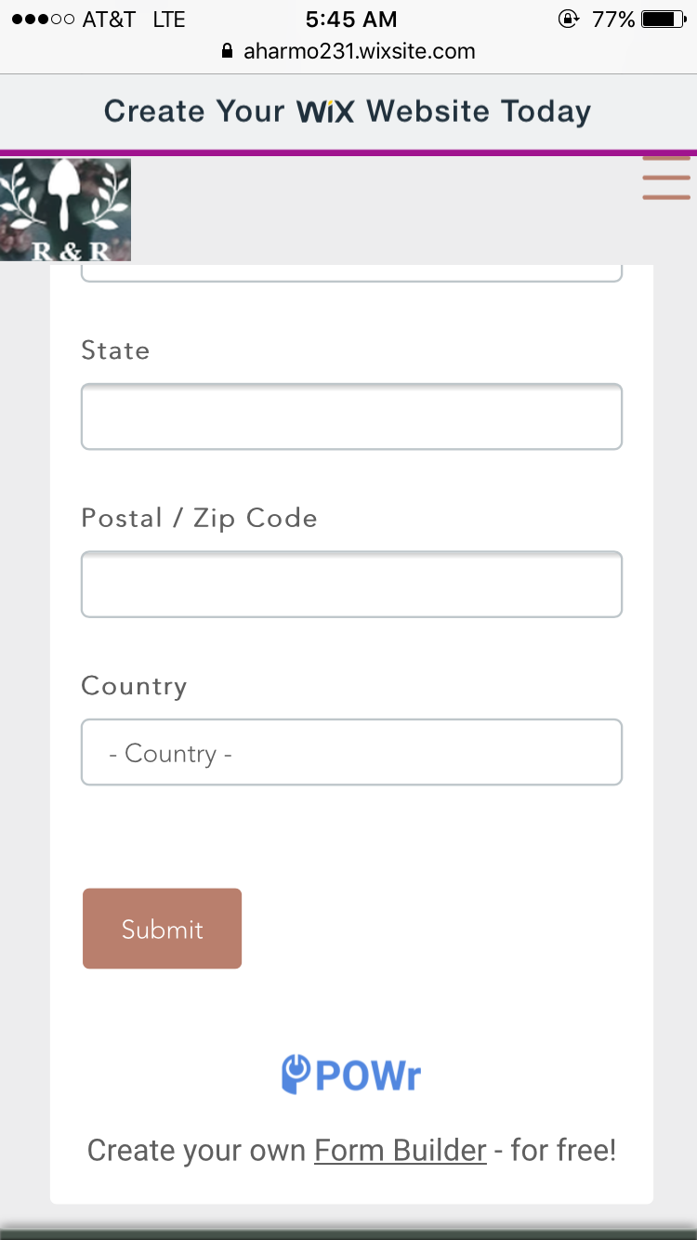
Schedule Item Transport
Notes:
If you accept a request for your donated item, you then schedule for the item to be transported, either picked up by a company driver or you dropping it off at the warehouse.

Slide 14
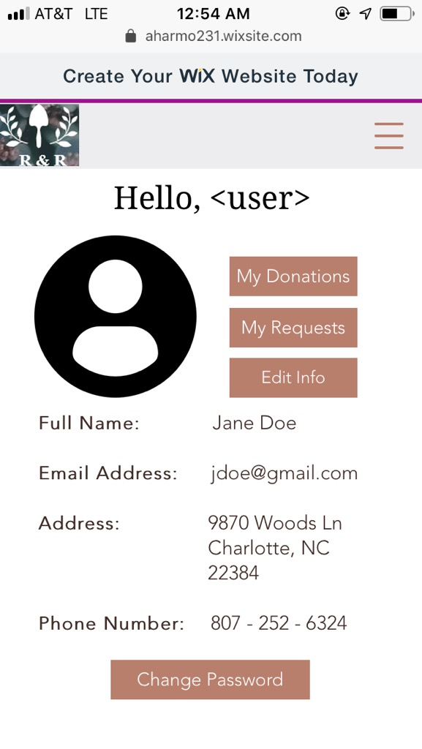
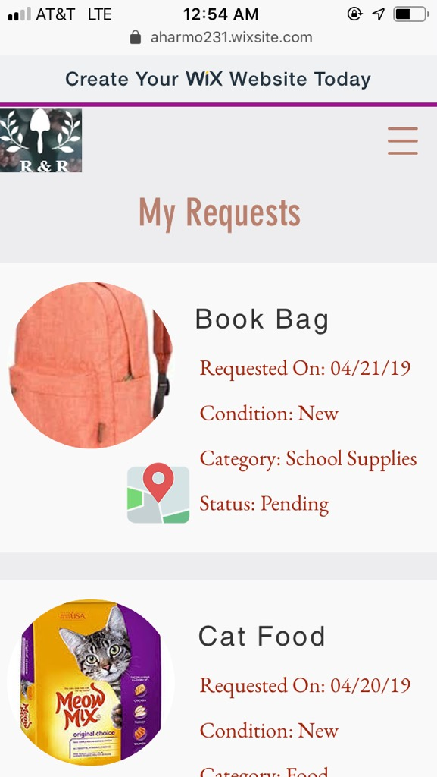
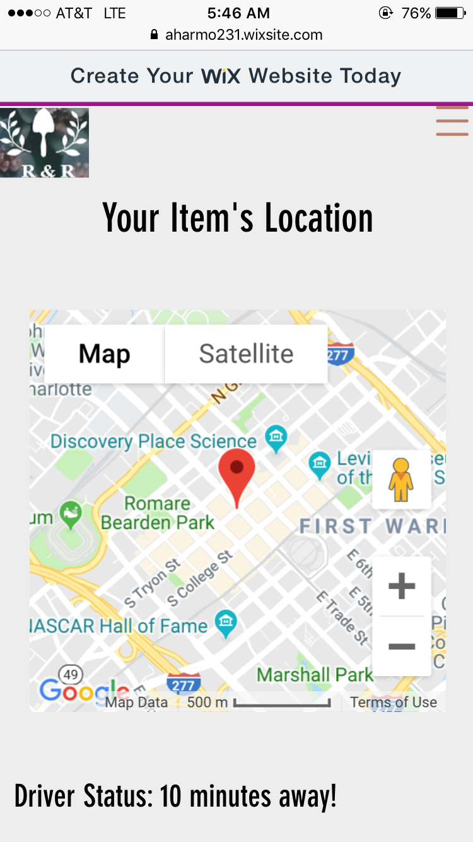
My Profile & My Requests
Location of Requested Item
Notes:
This is the profile page, having My Donations and My requests. With My Requests, if the request was accepted, you can track the location of the item if it’s on the way.

Slide 15
Pre-Study Survey Results
The ages of our participants ranged from 18 - 59 years old
The majority was between the ages of 19 - 26
For those with experience donating items, many had issues we wanted to solve (time, transportation, etc.)
If people looked for second-hand items, they also had issues we predicted (time, transportation, not finding what they need, etc.)
The majority had a lot of experience with using apps on their phone
With the exception of one or two middle-aged participants
The more experience users had with apps, the easier it was for them with ours
Notes:
We had participants fill out a brief survey before completing the tasks, and this is some of what we found

Slide 16
Post-Study Evaluation Results
Common Feedback:
The design and user interface was clean and intuitive
Layout and functionality made sense for the concept
Easier if the way the app works was understood better before using
Especially for things like schedule transport and track location
It was unclear that items appear within a specific distance range of the user
The location of My Donations and My Requests were unexpected by a majority
The difference between the Search and Request options was unclear
Icons, buttons, links were self-explanatory
The location tracking button was not obvious that it could be clicked on
Notes:
We recorded time taken, number of clicks, and thoughts spoken per task, as well as asked some follow up questions afterwards, and these are some of the common things we noticed.

Slide 17
Lessons Learned
Most people were happy with finding and using things 2 clicks away max
We can work on a way to keep things clean while keeping them quickly accessible
Any struggles finding things were usually due to confusion on how the app works
We can add a How To page or have a consistent help button that expands to searchable How To and/or About sections - This struggle increased with older participants
Many did not think My Requests and My Donations would be under My Profile
We can separate these into their own sections outside of the profile
Input would be most useful early in the design stage
Most feedback was extremely helpful and made sense once we heard it
Wording on tasks given to participants is extremely important
We needed to clarify some things more and word some pages/tasks better
Notes:
Given what we saw with the usability studies, we came up with some things we could do.

